Slide 1
CropBot
Ranuth Seneviratne

Slide 2
Technology in Agriculture
Robotics and image processing is used globally more and more in Agriculture to replace manual labor as,
It can perform hard work non stop
Labor is getting more and more expensive
Can perform tasks more accurately
While working can collect lot of data, eg: No. of flowers in each plant and how many were actually pollinated. If manually done these data wont be available for later analysis.
Can work on their own with out supervision

Slide 3
Problem to be solved
These international robots are,
Too expensive for local farmers
Too big for local farms – our farm scales are not that big
Specialized for specific tasks – Harvesting etc.
May not be adaptable for local growing methods
So medium scale farmers can not spend millions of rupees to buy such machines.
Some crops grown in green houses need Manual pollination as bees and insects are not present.
Pollination is a very labour required and expensive activity specially in crops such as vanilla as it need to be done during a specific time of the day.

Slide 4
My solution
A robotic arm guided by image processing that can be programed to perform multiple tasks in a medium size farm.
Arm would be fitted with different attachments for doing different tasks.
Tasks such as Weeding, Chemical Spraying, pollinating, harvesting etc. I am demonstrating Pollination in my project.
This arm would be mounted on a self drive vehicle. Guided by computer vision or/and lane guiding (Inside green houses) – to be developed.
Micro processor (Raspberry Pi) would be used for running the different programs that will control different tasks.
It can be powered with a battery or even solar panels in later development.
I have created a demonstration of one of the aspects, pollination.
It does this by using a 6DOF robotic arm with a spray tip at the end.
A camera is also fixed at the end of the arm and pump and a nozzle is used for spraying pollen.

Slide 5
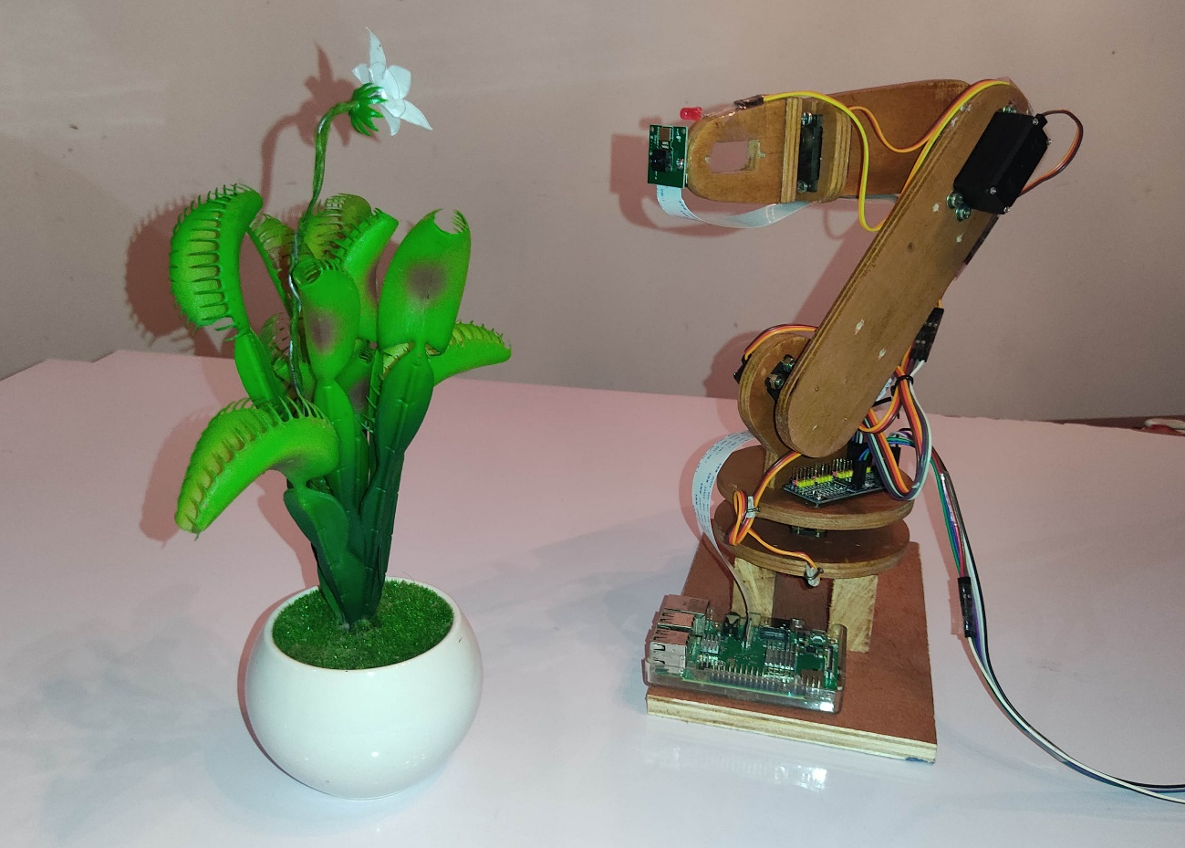
My robotic arm
I used 3 large MG996 servo motors for the positioning of the end effector, and two small MG90 servo motors for the rotation of the end effector.
At the tip I fixed a rasPiCam module, which is used to take photos.
I have used a relay to power a pump, and when the relay is turned on, it powers the LED and the pump at the same time.

Slide 6
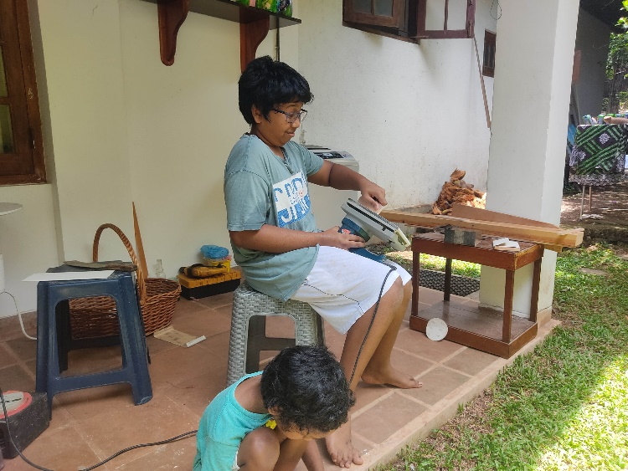
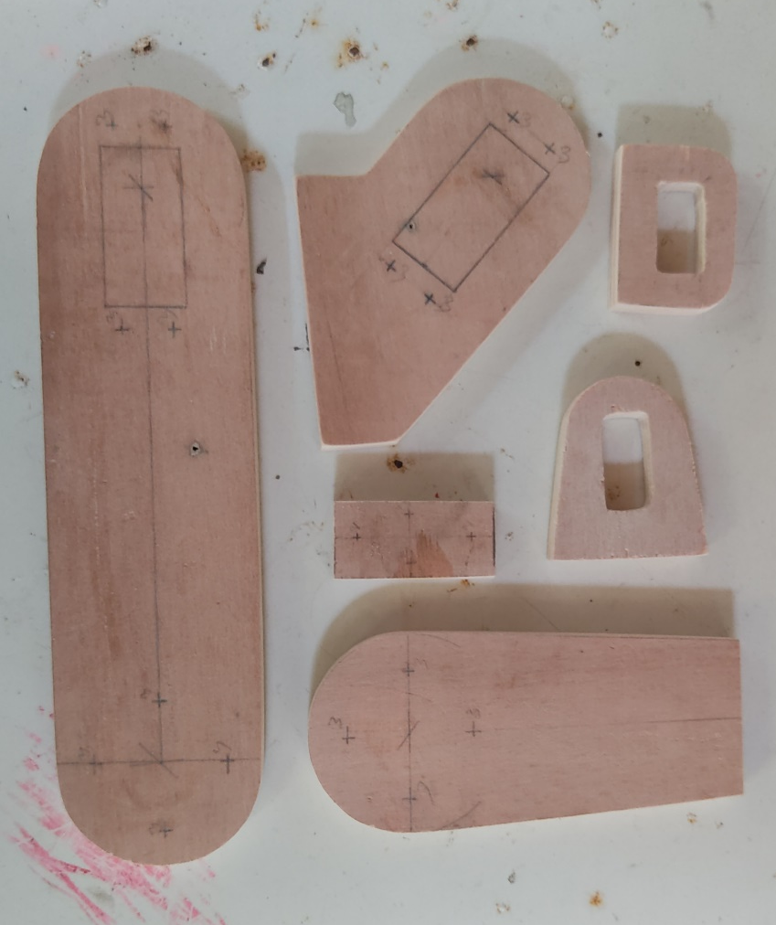
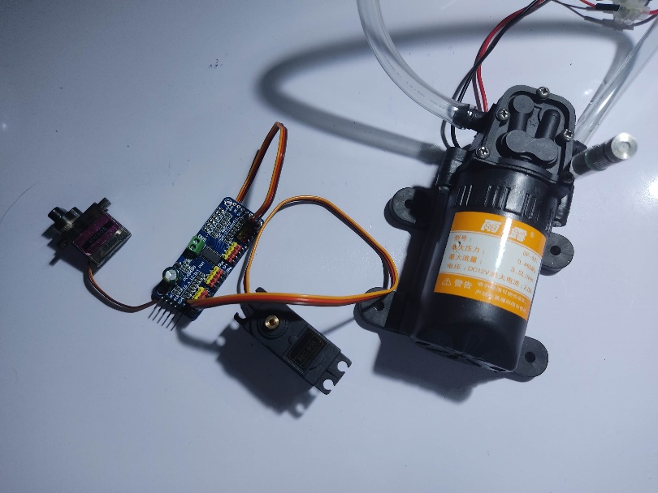
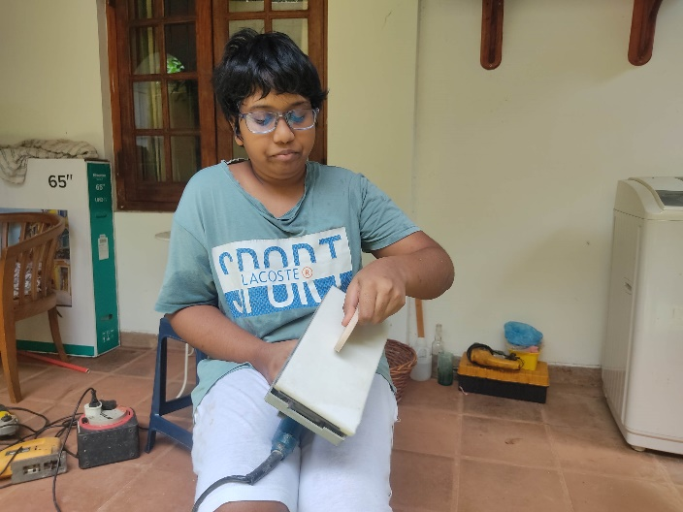

Slide 7
Main algorithm
Run flower finding algorithm
Is there a flower?
Start
Capture image
N
Y
Depending on the location of the flower, change the y and z coordinates. If it is in the center of the first window increase the x value. If it is in the center of the second window do the pollinating algorithm.
Output theta values to the PCA9685
Use the invKinemate function to convert x, y, z coordinated to theta values

Slide 8
Pollinating Algorithm
When called, do this
Turn the relay on (pin no.4 (BCM))
Sleep for 0.2 seconds
Turn the relay off (pin no.4 (BCM))
Stop

Slide 9
Flower Finding Algorithm
Input image which needs to be checked
For object n=0 get contours and convex hull
Start
Create a Binary mask image
N
Does it have 5 tips?
Get the amount of tips – check with the convex hull and check if each point is a peak
Convert X, Y coordinates to radial coordinates
Y
Output flowerBoxes
Y
Add the flower to the array “flowerBoxes”
Is n = the amount of contours
Get contours and convex hull
n=n+1
Stop
N

Slide 10
Extra notes on Inverse Kinematics
There are two ways of deriving theta values. Trigonometric method and Matrix method.
However as I haven’t learnt about matrices yet I decided to go forward with the Trigonometric method. This involves trigonometric functions and the Pythagoras theorem. I have a kinematic diagram and equations on the next slide.
I figured out the equations by myself and

Slide 11

Z
Kinematic diagram
θ3
Side view
e
θ2
θ6
a3
e
θ1
X
r2
θ$\text{1 = }\text{atan}\text{(}\text{X}\text{ 1_3 / }\text{Y}\text{ 1_3)}$
a2
Y 1_3
Z 1_3
θ4
r1 = sqrt(X 1_3²+Y 1_3²)
r2 = sqrt(r1²+(Z 1_3-a1)²)
Y
θ5
r1
θ4 = acos((r2²+a2²-a3²)/(2*r2*a2))
X 1_3
a1
Z 1_3
t5 = atan((Z 1_3-a1)/r1)
Top view
e
θ2 = θ2 - θ1
r1
t6 = acos((a1²+a2²-r2²)/(2*a1*a2))
θ3 = 180-θ6
Y 1_3
θ1
X 1_3

Slide 12
Extra information
Raspberry Pi Version – 2017 3B+
Opencv Version – 3.2.0
Numpy Version – 1.16.2
Python Version – 3.7.3

Slide 13

Thank you
Created by ranuth Seneviratne

